Slide 1

2026 Budget Presentation
The mission of the Lancaster County Government is to create a government that is effective, cost efficient, and consumer friendly.

Slide 2

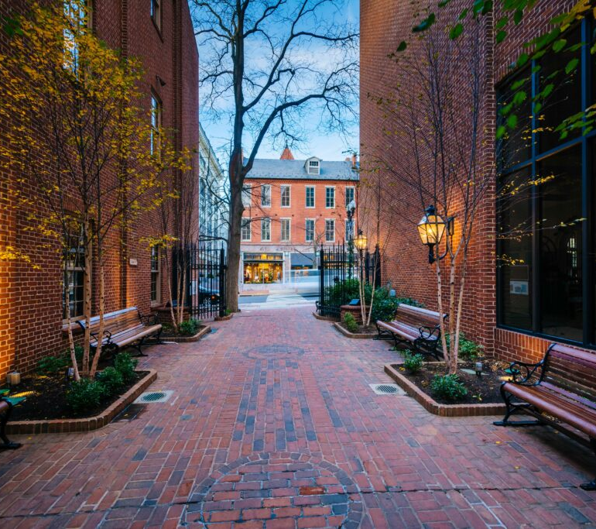
2026 Budget
Agenda
Welcoming Remarks
2026 Budget Highlights
2026 Budget Resolution
2025-2026 Comparison
Budget Breakdowns (Charts)
Agency Grants
Millage Rate History
Fund Balance Historical Data
Commissioners’ Comments
Public Comments and Questions
Photo credit: Kingsway Realty

Slide 3
Lancaster County Organizational Chart – Class 2A County
Voters
Commissioners* (3)
Elected Officials
Judicial
Chief Clerk
Deputy Chief Clerk
General Fund Agencies:
Agricultural Preservation
Board
Budget Services
Commissioners Office
Department of Public Safety
Elections Office
Facilities Management/ General Services
Human Resources
Information Technology
Prison
Planning
Property Assessment
Public Defender
Purchasing
Veterans Affairs
Funded Agencies:
Children & Youth
Agency
Drug & Alcohol
Commission
Behavioral Health/
Developmental
Services
Early Intervention
Office of Aging
Youth Intervention
Center
Controller*
Coroner*
Recorder of Deeds*
Treasurer*
Solicitor
Assistant Solicitor
Court of Common Pleas
Judges*
Court Administration
Adult Probation &
Parole Services
Court Reporters
Domestic Relations
Juvenile Probation
Law Library
Magisterial District Judges*
Retirement Board
County Commissioners
Controller
Treasurer
Salary Board
County Commissioners
Controller
Elected Department Heads
Election Board
County Commissioners
Prison Board
County Commissioners
Controller
District Attorney
Judge
Sheriff
Law Enforcement & Court Related (General Fund):
Criminal: Clerk of Courts*
Civil: Prothonotary*
Register of Wills*
Orphan’s Court Division
Sheriff*
District Attorney*
Victim Witness Program
Investment Board
Treasurer
Controller
Commissioner Chair
YIC Board
County Commissioners
Controller
6 at-large appointees
*denotes elected official(s)

Slide 4
2026 Budget
Budget Highlights
Total Expense Budget* = $339,971,302
  General Fund* = $201,945,900
  Funded Agencies and Liquid Fuels** = $138,025,402
Capital Improvement Fund: total expense of $10,109,623 for 2026
  $4,209,623 in 2025 rollover project costs
  $5,900,000 in 2026 project costs
10% Tax Increase for 2026
  Millage Rate moves from 2.911 to 3.201 mills
  Lowest Millage Rate of any Pennsylvania 2A County, as well as surrounding Counties
The 2026 budget includes the estimated use of $8,984,842 of reserve funds.
  GF Balance at 12/31/2026 projected at $61,421,407
1,929 County Staffing Positions Funded for 2026.
Bond Rating of Aa2, third highest of the twenty (20) ratings.
* Excludes fund balance.
** Funded agencies include Domestic Relations, Office of Aging, Drug & Alcohol, Behavioral Health/Developmental Services, Children & Youth, and the Youth Intervention Center.

Slide 5
2026 Budget
Proposed Budget Resolution #75 Revenue
 |  |  |  |  | GENERAL FUND |  | FUNDED AGENCIES & LIQUID FUELS |  | TOTAL
REVENUE
County Tax Receipts—2026
Real Estate (3.201 Mills) |  |  |  |  | $ 142,786,672 |  |  |  | $ 142,786,672
Delinquent Taxes |  |  |  |  | 1,823,000 |  |  |  | 1,823,000
Total County Tax Receipts—2026 |  |  |  |  | $ 144,609,672 |  |  |  | $ 144,609,672
State & Federal Grants—2026 |  |  |  |  | 7,114,190 |  | 112,302,547 |  | 119,416,737
Fees & Fines—2026 |  |  |  |  | 39,737,196 |  | 6,465,699 |  | 46,202,895
Interest Earnings—2026 |  |  |  |  | 1,500,000 |  | 878,596 |  | 2,378,596
County Match-2026 |  |  |  |  |  |  | 18,292,711 |  | 18,292,711
TOTAL 2026 RECEIPTS |  |  |  |  | $ 192,961,058 |  | $ 137,939,553 |  | $ 330,900,611
Estimated Fund Balance Available 12/31/25 |  |  |  |  | $ 70,406,249 |  | $ 11,584,917 |  | $ 81,991,166
Total Receipts & Fund Balance |  |  |  |  | $ 263,367,307 |  | $ 149,524,470 |  | $ 412,891,777

Slide 6
2026 Budget
Proposed Budget Resolution #75 Expenditures
 |  |  |  |  |  | GENERAL FUND |  | FUNDED AGENCIES & LIQUID FUELS |  | TOTAL
Payroll & Fringe Benefits |  |  |  |  |  | $ 117,676,966 |  | $ 51,041,643 |  | $ 168,718,608
Other Operating Expenditures |  |  |  |  |  | 47,733,684 |  | 84,723,007 |  | 132,456,692
Capital |  |  |  |  |  | 599,050 |  | 2,260,752 |  | 2,859,802
Debt Service |  |  |  |  |  | 15,540,278 |  |  |  | 15,540,278
Radio Project Lease & Interest |  |  |  |  |  | 0 |  |  |  | 0
County Match |  |  |  |  |  | 17,293,198 |  |  |  | 17,293,198
Affiliated Agency/Capital Project Grants |  |  |  |  |  | 2,560,716 |  |  |  | 2,560,716
RRTA Funding |  |  |  |  |  | 542,008 |  |  |  | 542,008
TOTAL 2026 OPERATING EXPENDITURES |  |  |  |  |  | $ 201,945,900 |  | $ 138,025,402 |  | $ 339,971,302
Estimated Fund Balance Remaining 12/31/26 |  |  |  |  |  | $ 61,421,407 |  | $ 11,499,068 |  | $ 72,920,475
Total 2026 Operating Expenditures
And Fund Balance Remaining 12/31/26 |  |  |  |  |  | $ 263,367,307 |  | $ 149,524,470 |  | $ 412,891,777
TAX RATE ON ASSESSED VALUE OF REAL ESTATE = 3.201 MILLS
TAXABLE ASSESSED VALUE = $45,286,188,100
TAX INCREASE OVER 2025 = 10%

Slide 7
2026 Budget
General Fund Revenue Summary
2026 PROPOSED BUDGET
REVENUE SUMMARY
 |  |  | 2026 Budget vs
 |  |  |  | 2025 Orig Budget
 | 2026 Budget | 2025 Forecast | 2025 Forecast |  | 2024 Actual
Real Estate/Delinquent Tax Receipts | 144,609,672 | 130,143,172 | 14,466,500 | 130,175,084 | 128,531,859
Fees & Fines | 33,809,340 | 33,471,683 | 337,657 | 29,352,693 | 30,183,562
Interest Earnings | 1,500,000 | 7,200,000 | (5,700,000) | 6,600,000 | 2,853,177
Rent & Royalty | 1,545,268 | 1,352,407 | 192,861 | 1,651,291 | 1,520,916
Total - County Generated Revenue | $ 181,464,280 | $ 172,167,262 | $ 9,297,018 | $ 167,779,068 | $ 163,089,514
Federal Grants | 1,644,036 | 2,075,258 | (431,222) | 1,785,738 | 1,708,861
State Grants/Direct | 3,394,091 | 3,408,095 | (14,004) | 5,221,579 | 5,900,094
Other Governmental | 257,000 | 262,403 | (5,403) | 305,345 | 157,626
Election Integrity Grant Program | 1,819,063 | 1,850,183 | (31,120) | 1,819,063 | 1,819,062
Total - Intergovernmental Revenue | $ 7,114,190 | $ 7,595,939 | $ (481,749) | $ 9,131,725 | $ 9,585,642
Indirect/Intra-County Revenue | 4,382,588 | 4,611,261 | (228,673) | 3,839,984 | 4,308,207
Total Revenue | $ 192,961,058 | $ 184,374,462 | $ 8,586,596 | $ 180,750,777 | $ 176,983,364

Slide 8
2026 Budget
General Fund Expense Summary
2026 PROPOSED BUDGET
EXPENSE SUMMARY
 |  |  | 2026 Budget vs
 |  |  |  | 2025 Orig Budget
 | 2026 Budget | 2025 Forecast | 2025 Forecast |  | 2024 Actual
Salary | 84,199,233 | 73,336,067 | 10,863,166 | 76.655.957 | 76,673,293
Benefits | 20,364,216 | 18,251,576 | 2,112,640 | 17,001,821 | 14,439,325
Retirement/Payroll Taxes/Fringe | 13,113,517 | 13,125,408 | (11,891) | 14,109,319 | 11,633,683
Total - Personnel Services | $ 117,676,966 | $ 104,713,051 | $ 12,963,915 | $ 107,767,097 | $ 102,746,301
Other Operating Expenses | 47,733,684 | 41,591,334 | 6,142,350 | 40,906,193 | 37,203,125
Capital Expenditures | 599,050 | 180,312 | 418,738 | - | 332,110
Agency Grants | 2,560,716 | 2,560,716 | 0 | 2,560,716 | 3,529,875
RRTA Grant | 542,008 | 455,755 | 86,253 | 455,755 | 498,569
Debt Services (Bond & Interest) | 15,540,278 | 15,827,169 | (286,891) | 15,517,556 | 10,239,674
County Match | 17,293,198 | 17,293,198 | 0 | 16,723,306 | 12,366,970
Radio (Lease & Interest) | - | 2,226,973 | (2,226,973) | 2,226,973 | 2,226,973
Total - All Other | $ 84,268,934 | $ 80,135,457 | $ 4,133,477 | $ 78,390,499 | $ 66,397,296
Total Expense | $ 201,945,900 | $ 184,848,508 | $ 17,097,392 | $ 186,157,596 | $ 169,143,597
Total Revenue (from last slide) | $ 192,961,058 | $ 184,374,462 | $ 8,586,596 | $ 180,750,777 | $ 176,983,364
Projected Fund Balance Incr/(Decr) | $ (8,984,842) | $ (474,046) | N/A | $ (5,406,819) | $ 7,839,767

Slide 9
2026 Budget
2025 vs. 2026 General Fund Comparison
REVENUE | 2025 ADOPTED BUDGET |  | 2026 PROPOSED BUDGET |  | VARIANCE | % CHANGE |  | 2024 ACTUALS
County Tax Receipts | $130,175,084 |  | $144,609,672 |  | $14,434,588 | 11.09% |  | $128,531,859
State & Federal Grants | $7,312,662 |  | $7,114,190 |  | ($198,472) | -2.71% |  | $9,585,642
Fees & Fines | $36,663,030 |  | $39,737,196 |  | $3,074,166 | 8.38% |  | $36,012,686
Interest Earnings | $6,600,000 |  | $1,500,000 |  | ($5,100,000) | -77.27% |  | $2,853,177
TOTAL RECEIPTS | $ 180,750,776 |  | $ 192,961,058 |  | $12,210,282 | 6.76% |  | $176,983,364
EXPENDITURES
Payroll & Fringe Benefits | $107,767,097 |  | $117,676,966 |  | $9,909,869 | 9.20% |  | $102,746,301
Other Operating Expenditures | $40,906,193 |  | $47,733,684 |  | $6,827,491 | 16.69% |  | $37,203,125
Capital | $0 |  | $599,050 |  | $599,050 | 100% |  | $332,110
Debt Service | $15,517,556 |  | $15,540,278 |  | $22,722 | 0.15% |  | $10,239,674
Radio Lease & Interest | $2,226,973 |  | $0 |  | ($2,226,973) | -100.00% |  | $2,226,973
County Match | $16,723,306 |  | $17,293,198 |  | $569,892 | 3.41% |  | $12,366,970
Affiliated Agency Grants | $2,560,716 |  | $2,560,716 |  | $0 | 0.00% |  | $3,529,875
RRTA Funding | $455,755 |  | $542,008 |  | $86,253 | 18.93% |  | $498,569
TOTAL OPERATING EXPENDITURES | $ 186,157,596 |  | $ 201,945,900 |  | $15,788,304 | 8.48% |  | 169,143,597

Slide 10
2026 Budget
General Fund Revenue Breakdown

Slide 11
2026 Budget
General Fund Major Expenses Breakdown

Slide 12
2026 Budget
General Fund Payroll Expense Budget Breakdown

Slide 13
2026 Budget
General Fund Non-Payroll Expense Budget Breakdown

Slide 14
2026 Budget
County Budget Expense Breakdown (All Funds)

Slide 15
2026 Budget
Expenses for Judicial Operations (General Fund)
Expenses for Judicial Operations (General Fund)

Slide 16
2026 Budget
Expenses for Funded Agencies
GF County Match dollars make up $17,293,198 of this total.

Slide 17
2026 Budget
Agency Grants
 |  | General Fund | Act 13 Funds
Agricultural Extension (Penn State College of Ag) |  | $474,955
Library System |  | $1,756,894
Member Libraries |  | $186,750
Lancaster Conservation District |  |  | $250,000
Economic Development Company of Lancaster |  | $87,150
Downtown Investment District |  | $54,967
Lancaster Ag Council |  |  | $20,000
Susquehanna Heritage |  |  | $30,000
Ag Preserve/Farmland Trust |  |  | $250,000
Lancaster Conservancy |  |  | $150,000
Grand Total |  | $2,560,716 | $700,000
SCTA Funding |  | $542,008

Slide 18
2026 Budget
Millage Rate History
2017
3.735 County millage (0% increase)
2018
2019
2.911 County millage (0% increase)
2020
2.911 County millage (0% increase)
2021
2.911 County millage (0% increase)
2022
2023
2.911 County millage (0% increase)
2.911 County millage (0% increase)
2024
2.911 County millage (0% increase)
2025
2.911 County millage (0% increase)
2.911 County millage (0% revenue increase)
Reassessment
2026
3.201 County millage (10% increase)
Millage Rate History

Slide 19
2026 Budget
General Fund Revenue & Expenses- 2021-2025

Slide 20
2026 Budget
General Fund- Fund Balance History- 2020-2026

Slide 21
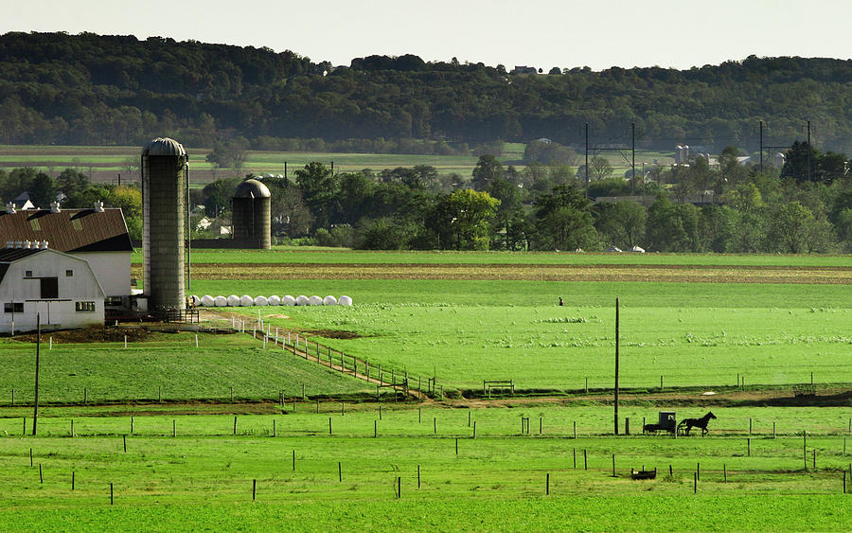
2026 Budget
Commissioners & Public Comments/Questions
Photo credit: Ryan Donnell
Copies of this presentation and all budget reports can be found on our website at https://www.co.lancaster.pa.us/591/Budget-Financial-Information

